Slide 1
Part I.
What is Machine Learning?

Slide 2
Input
Traditional
Programming
Output
Rules

Slide 3
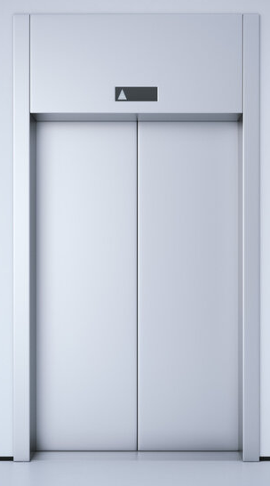
Elevator Algorithm
Button Inputs
Elevator moves
to desired floor
Find and move
to desired floor

Slide 4

Dog Detector
Dog Photo
Dog? (Y/N)
Find and isolates
features unique to
a dog

Slide 5
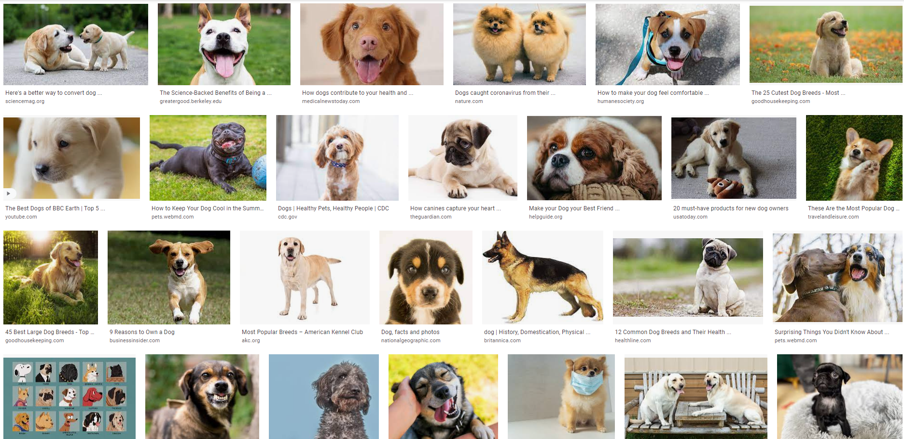

Slide 6
Sample Input
Machine
Learning
Rules
Output

Slide 7
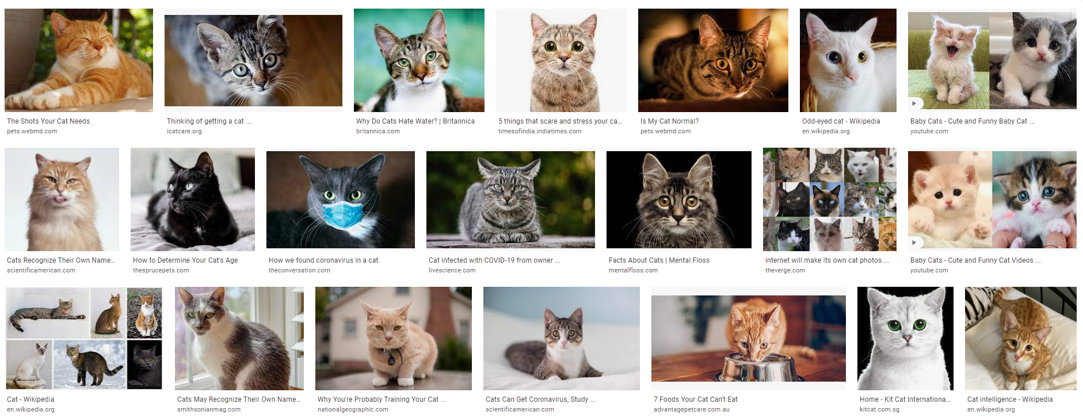
[1,1,1,1,1,1,1 ...]
Machine
Learning
Rules
Model
[0,0,0,0,0,0...]

Slide 8
Actual Input
Machine
Learning
Application
Output
Trained Model

Slide 9
Machine Learning Categories

Slide 10
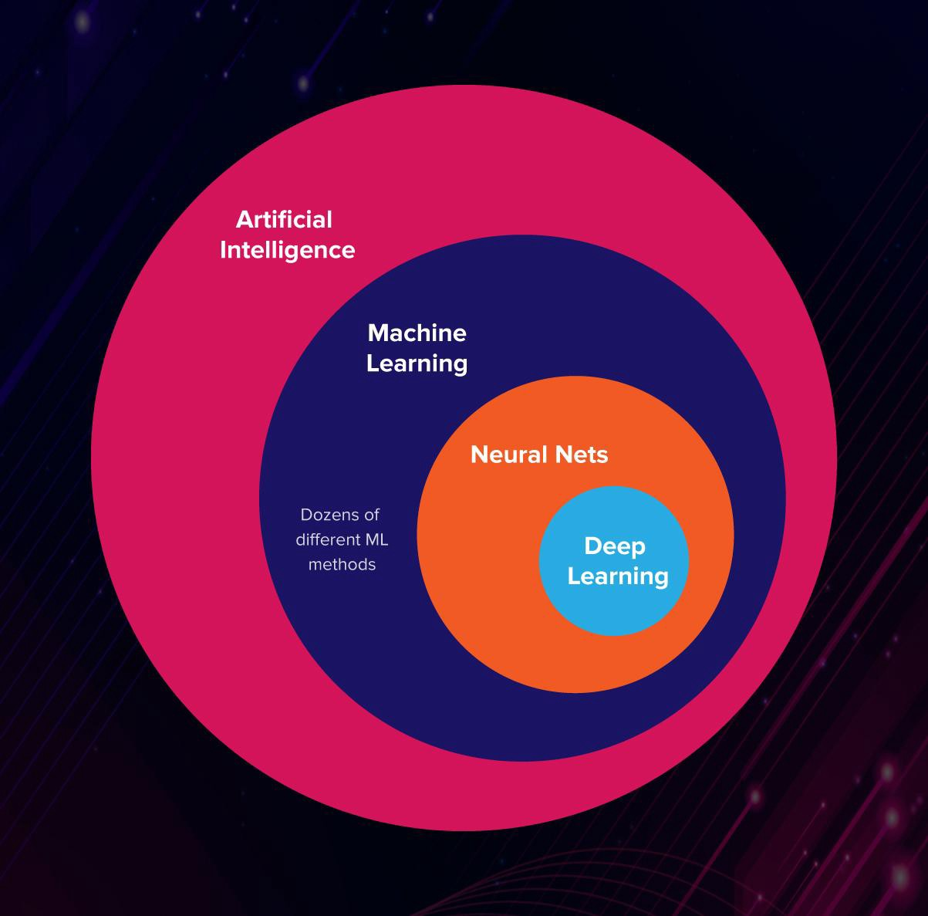
Artificial Intelligence
vs
Machine Learning
vs
Deep Learning

Slide 11
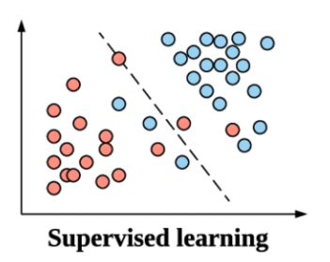
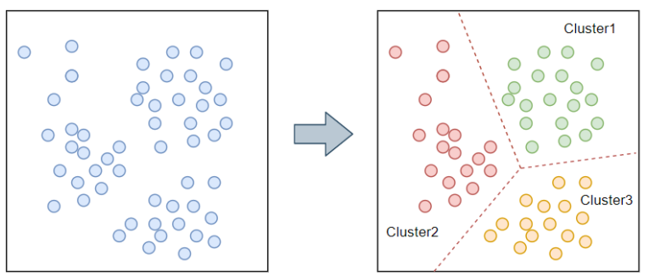
Supervised Learning vs Unsupervised Learning
Supervised
Unsupervised
Model is trained in labelled data
Unlabelled data is given,
model is tasked to figure out
specific classes

Slide 12
Supervised Learning Types
Regression vs Classification
Regression
Classification
Predicts continuous values
Predicts distinct classes
(Y or N, 1 or 0)
Ex: Estimate the price of a house
given floor space in sqm.
Ex: Given size of tumor,
classify if benign or malignant

Slide 13
Part II.
Machine Learning Examples

Slide 14
Regression Example
Floor Space (sqm) | Rent (1k PHP /mo)
10 | 7
12 | 12
15 | 10
17 | 14
19 | 16
22 | 19
25 | 20
25 | 23
Feature (X)
Label (y)

Slide 15
Regression Example
Floor Space (sqm) | Rent (1k PHP /mo)
10 | 7
12 | 12
15 | 10
17 | 14
19 | 16
22 | 19
25 | 20
25 | 23
Feature (X)
Label (y)

Slide 16
Regression Example
Floor Space (sqm) | Rent (1k PHP /mo)
10 | 7
12 | 12
15 | 10
17 | 14
19 | 16
22 | 19
25 | 20
25 | 23
Feature (X)
Label (y)

Slide 17
Floor Space
Machine
Learning
Regression Model
(Linear)
Rent

Slide 18
Input Floor Space
(40 sqm)
Machine
Learning
Application
Output Rent (PHP 35k/mo)
Trained LRM

Slide 19
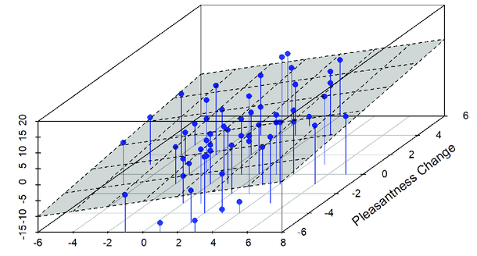
Second Order Regression Example
Label
Feature 2
Feature 1

Slide 20
Classification Example
Tumor Diameter (cm) | Malignant?
0.5 | 0
0.7 | 0
1 | 0
1.2 | 0
2.5 | 1
3 | 0
3.7 | 1
4.8 | 1
Feature (X)
Label (y)

Slide 21
Tumor Diameter
Machine
Learning
Classification Model
(Logistic Regression)
Maglinant? (1 or 0)

Slide 22
Input Tumor Diameter
(6 cm)
Machine
Learning
Application
Output Classification (0.997)
Trained CM

Slide 23
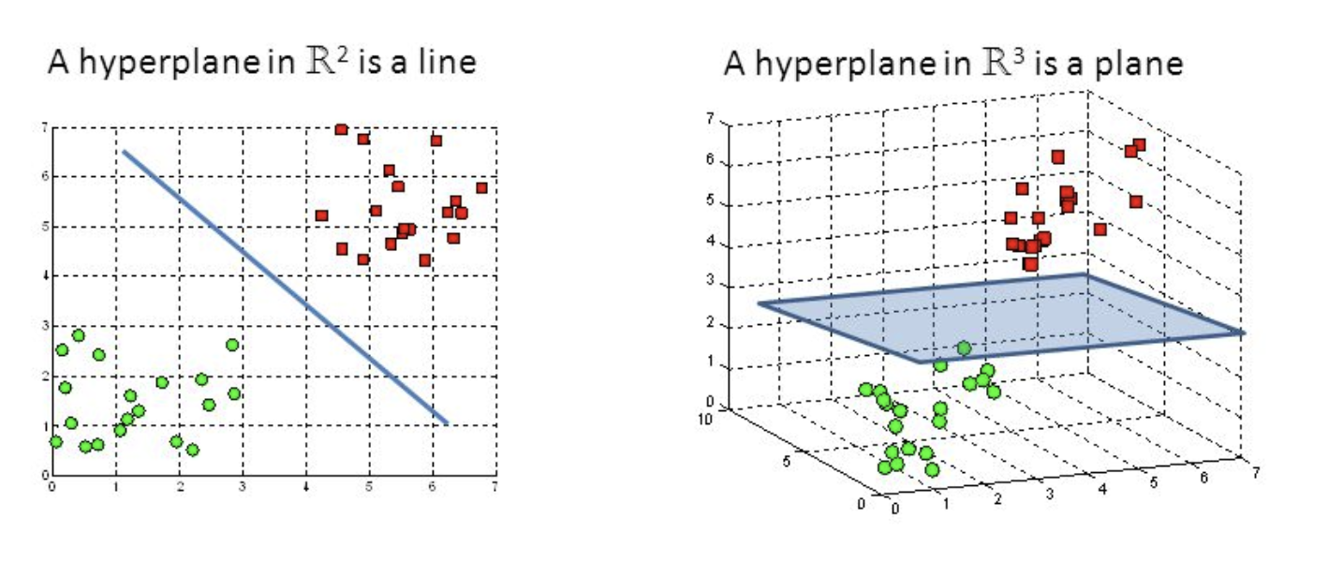
Second Order Classification Example

Slide 24
Part III.
Machine Learning in Python

Slide 25
Part IV.
How Machine Learning works

Slide 26

coursera.org/learn/machine-learning

